Slide 1


BUILD YOUR PERSONAL AI AGENT WITH CLAUDE CODE

Slide 2
RUNNING THE 10 AUTOMATIONS (WHAT TO EXPECT)

Slide 3

10 Automations. All Connected.
01
02
03
04
05
Sprint Tracker
Morning Brief
Market Pulse
Research Team
Personal CRM
Project board
Daily snapshot
Competitor radar
Multi-agent research
Relationship tracker
© All rights reserved for Dr. Ryan Ahmed @Stemplicity Inc.
06
07
08
09
10
Meeting Intel
Email Triage
Expense Wrangler
Content Machine
Weekly Exec Report
Prep & extraction
Inbox manager
Receipt processing
Multi-format content
Capstone rollup
Each automation reads from the vault, does its job, and writes back. The system compounds.

Slide 4
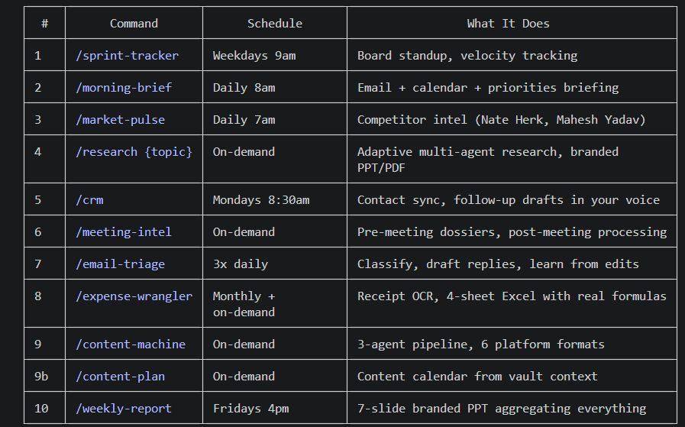
10 Automations. All Connected.
© All rights reserved for Dr. Ryan Ahmed @Stemplicity Inc.

Slide 5
SPRINT TRACKER

Slide 6
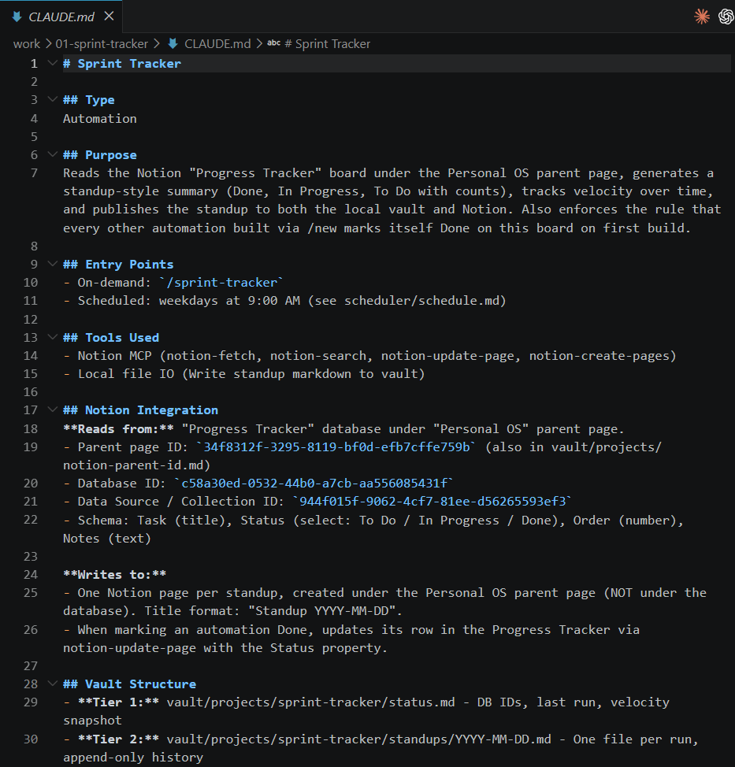
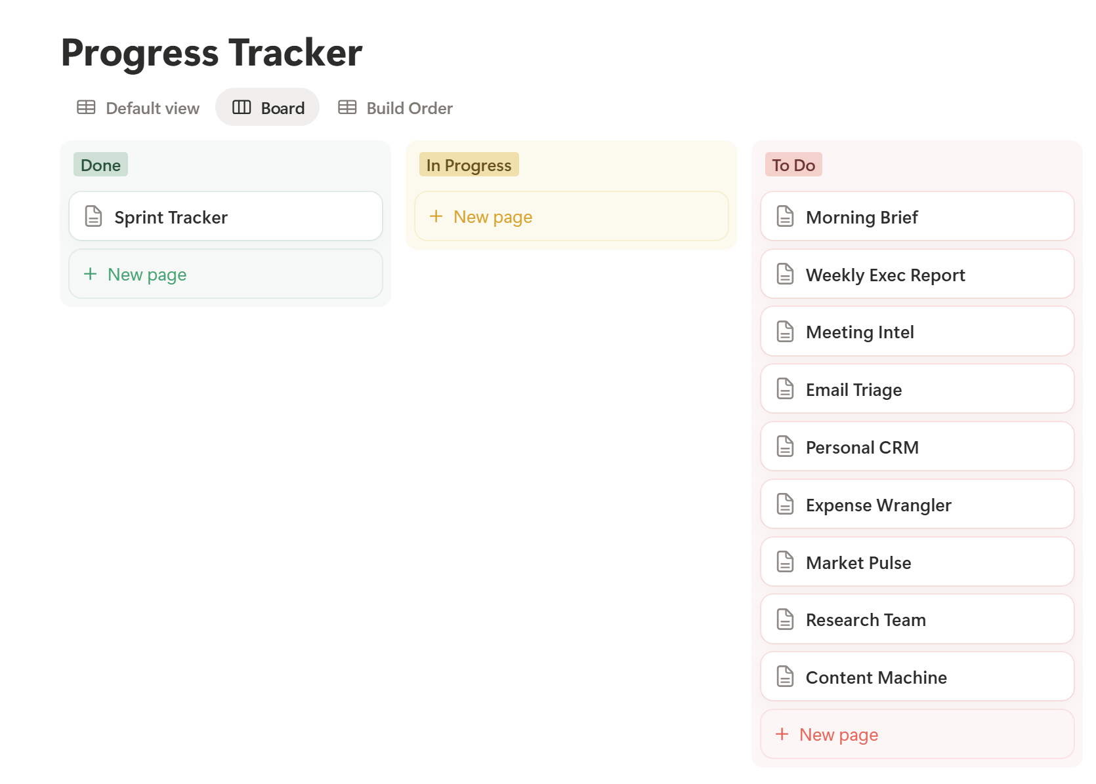
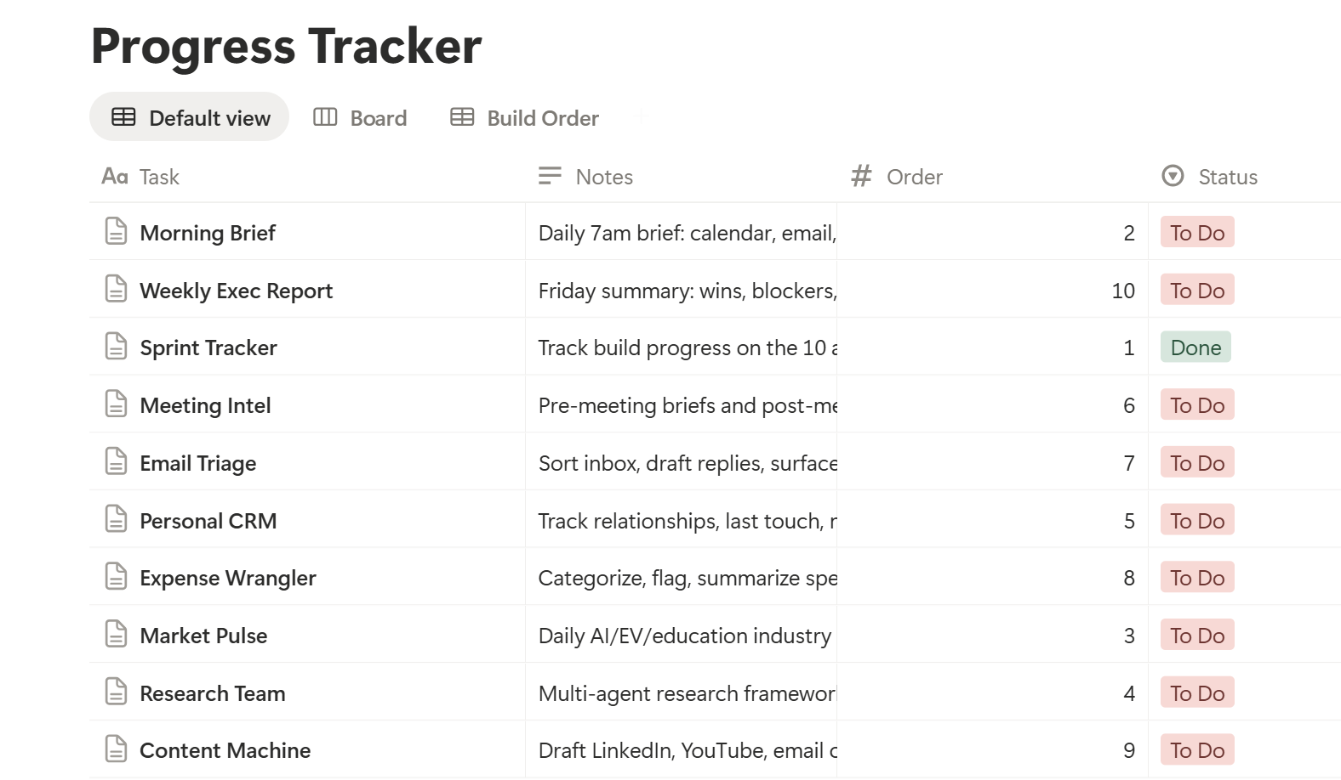
Prompt 1: Sprint Tracker
After running the sprint tracker, a Claude.md file is created under the work folder
Check the Notion page, and you should see this task highlighted in green and marked as Done!
What does the automation do?
It looks at your Notion “Progress Tracker” board
It checks all your tasks and their status: To Do, In Progress, Done
Then it creates a summary report (like a daily standup)
© All rights reserved for Dr. Ryan Ahmed @Stemplicity Inc.

Slide 7
MORNING BRIEF

Slide 8
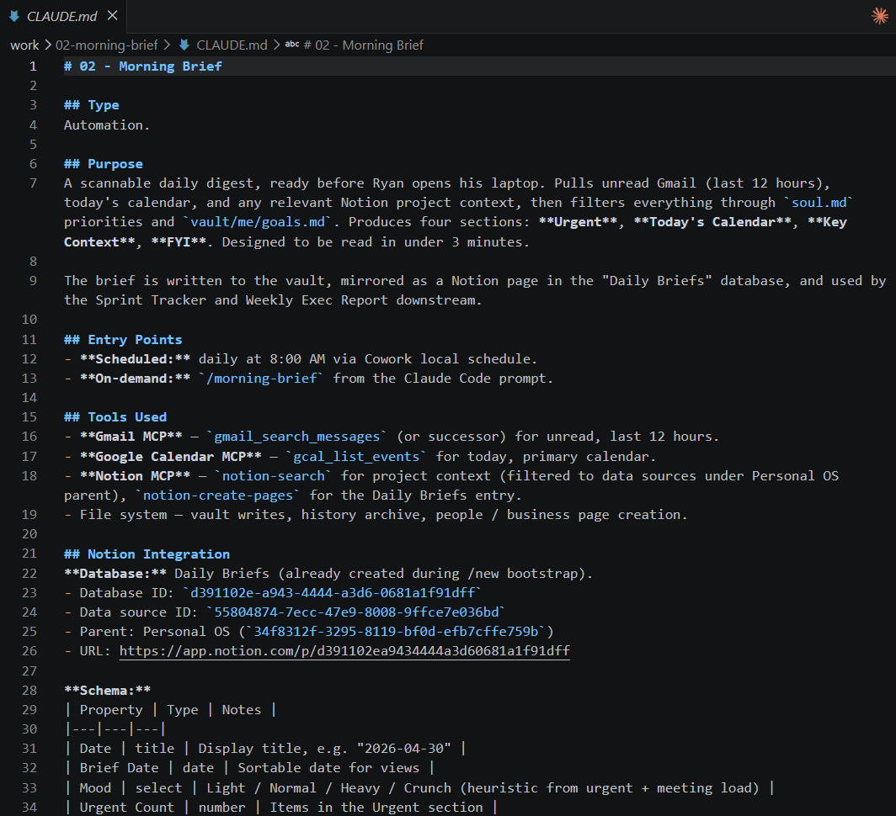
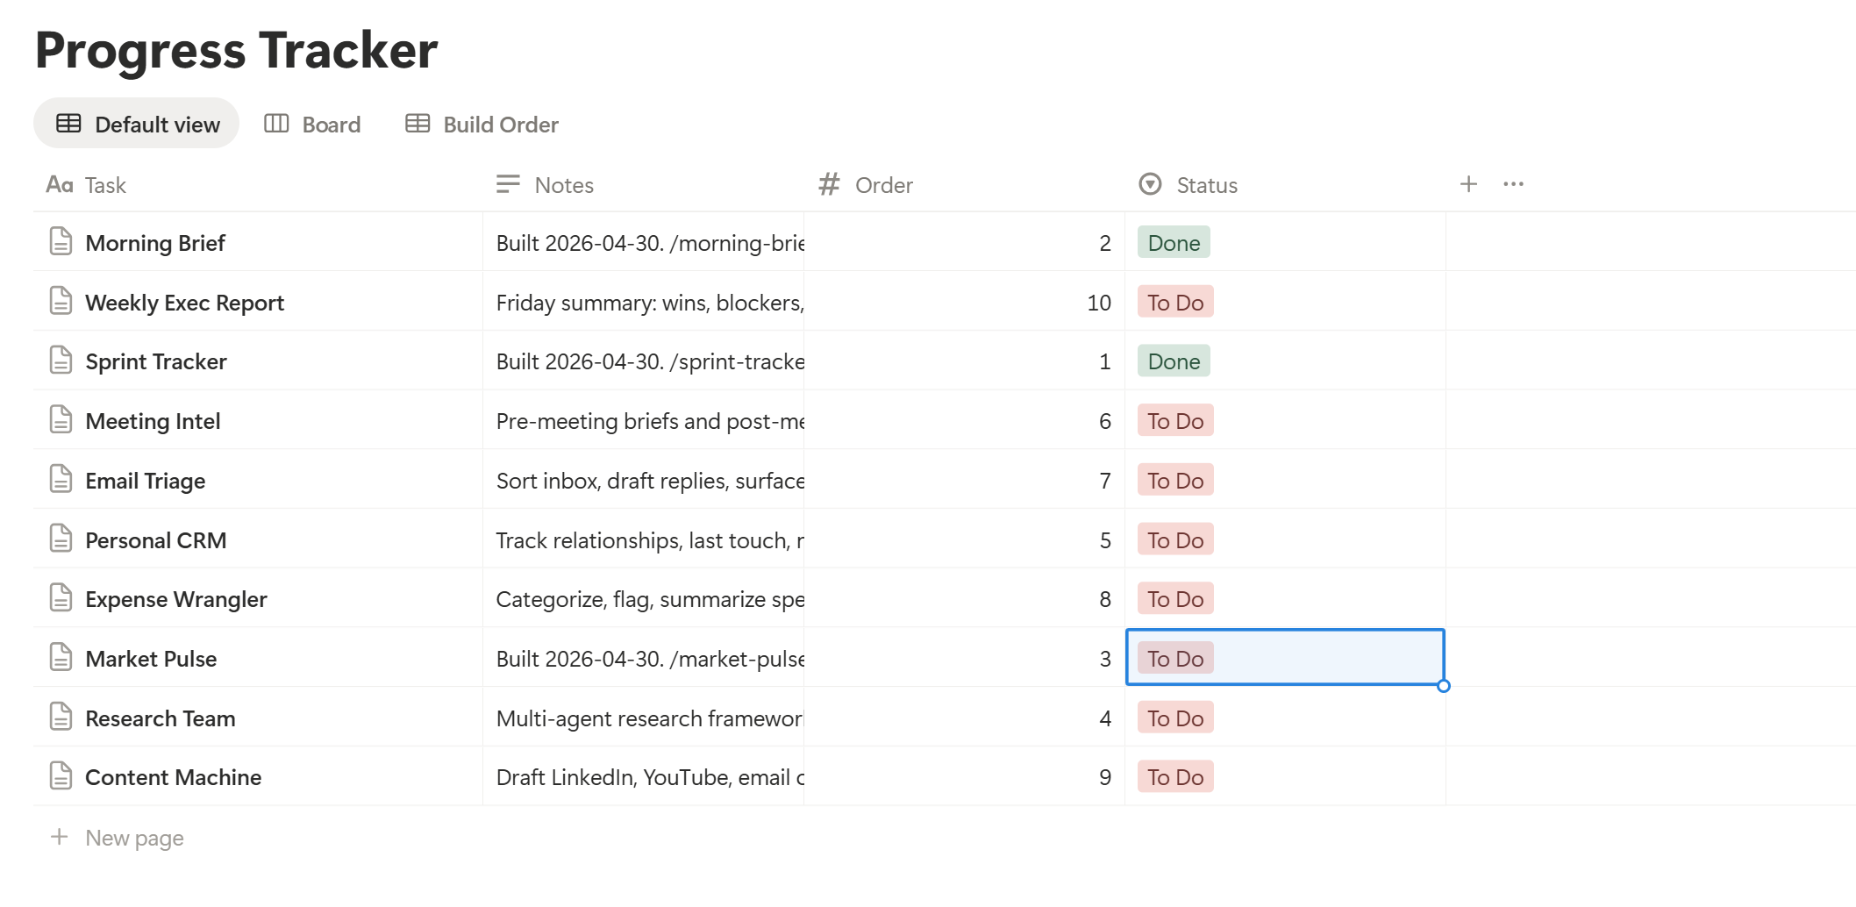
Prompt 2: Morning Brief
After running the morning brief, a Claude.md file is created under the work folder along with a new slash command.
Note that the notion board has also been updated.
© All rights reserved for Dr. Ryan Ahmed @Stemplicity Inc.

Slide 9
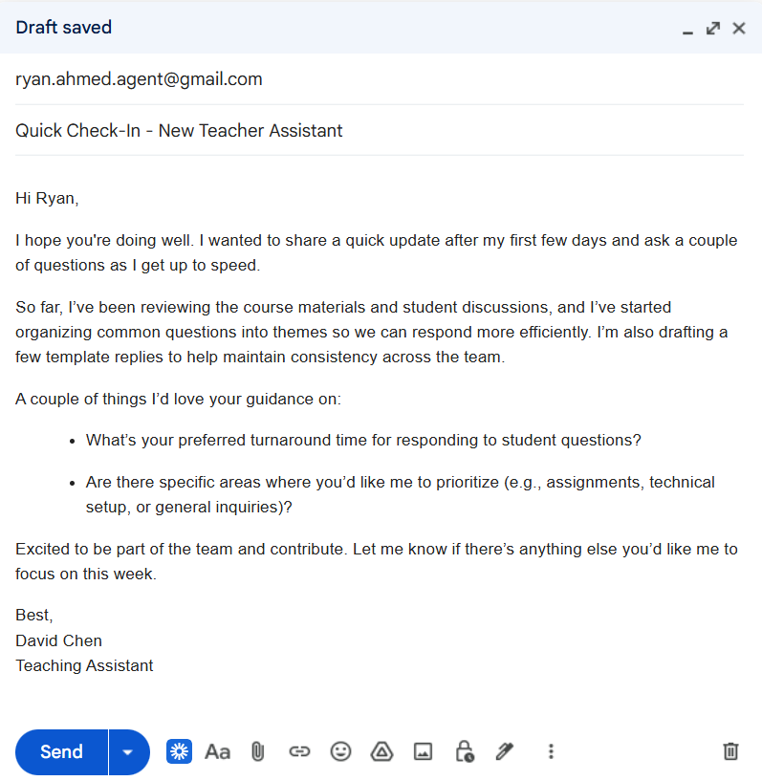
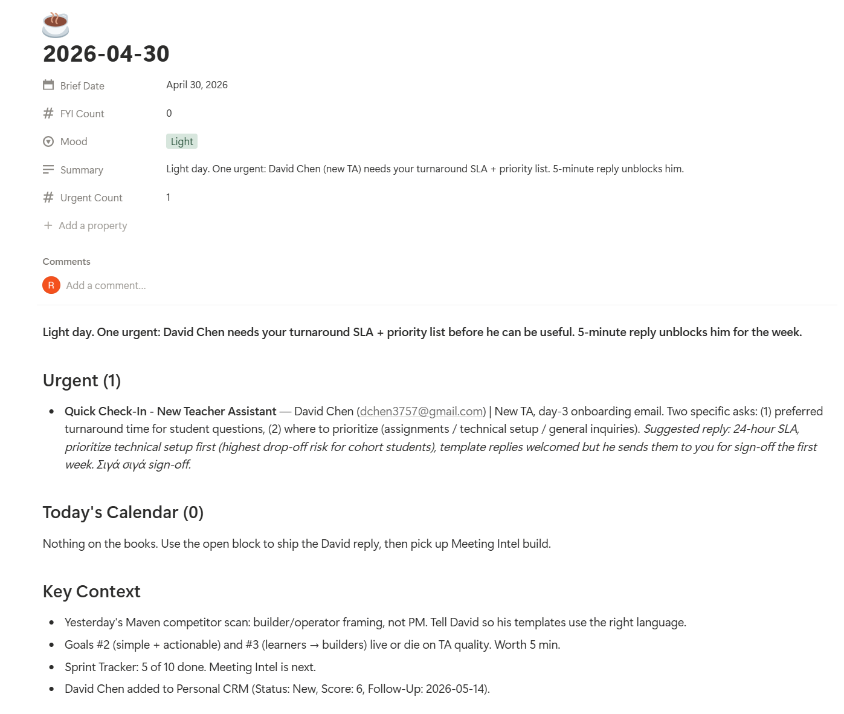
Let’s test the Morning Brief
Assume that David Chen sent this email to me.
Now run /morning-brief and check out the Notion page.
© All rights reserved for Dr. Ryan Ahmed @Stemplicity Inc.

Slide 10
DISPATCH

Slide 11
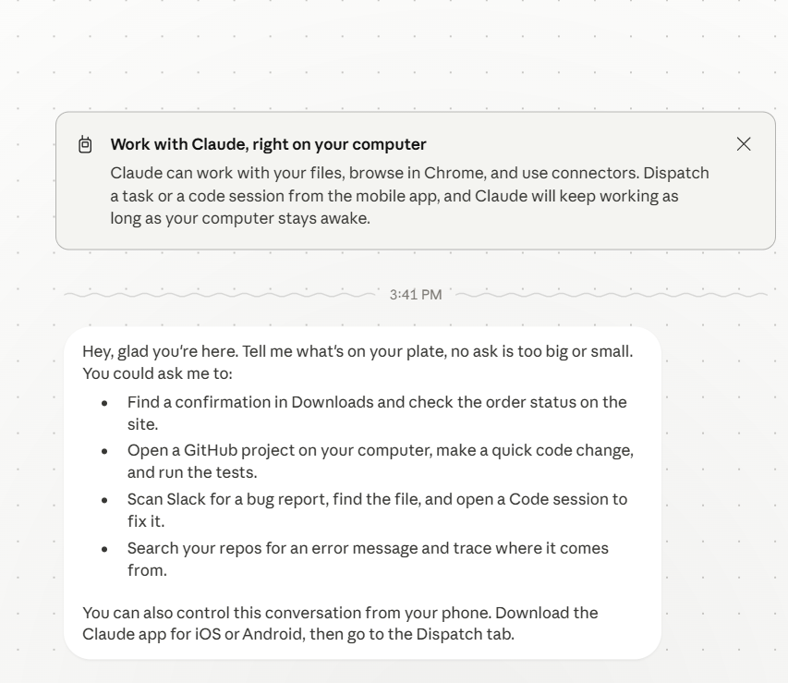
Dispatch
Claude Dispatch model allow you to message Claude from your phone on the way to work, then follow up from your desktop when you sit down. It's the same conversation, same context, wherever you reach it.
When you assign a task, Claude figures out what kind of work is needed and spins up the right session. Development tasks run in Claude Code; knowledge work runs in Cowork. These sessions appear in their respective sidebars. You can click into any session for details, or wait for the result in the thread.
© All rights reserved for Dr. Ryan Ahmed @Stemplicity Inc.
https://support.claude.com/en/articles/13947068-assign-tasks-from-anywhere-in-claude-cowork

Slide 12
MARKET PULSE

Slide 13
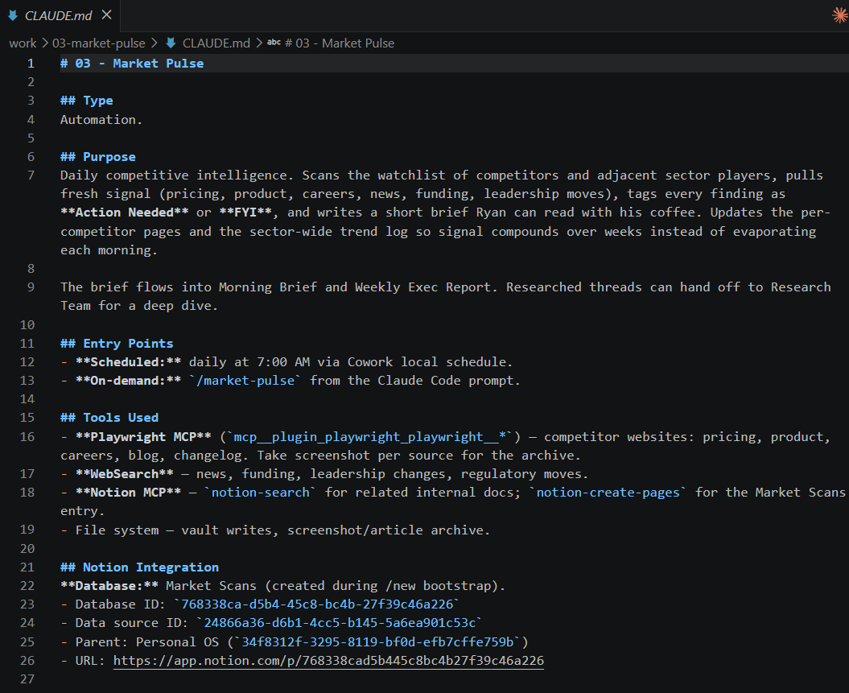
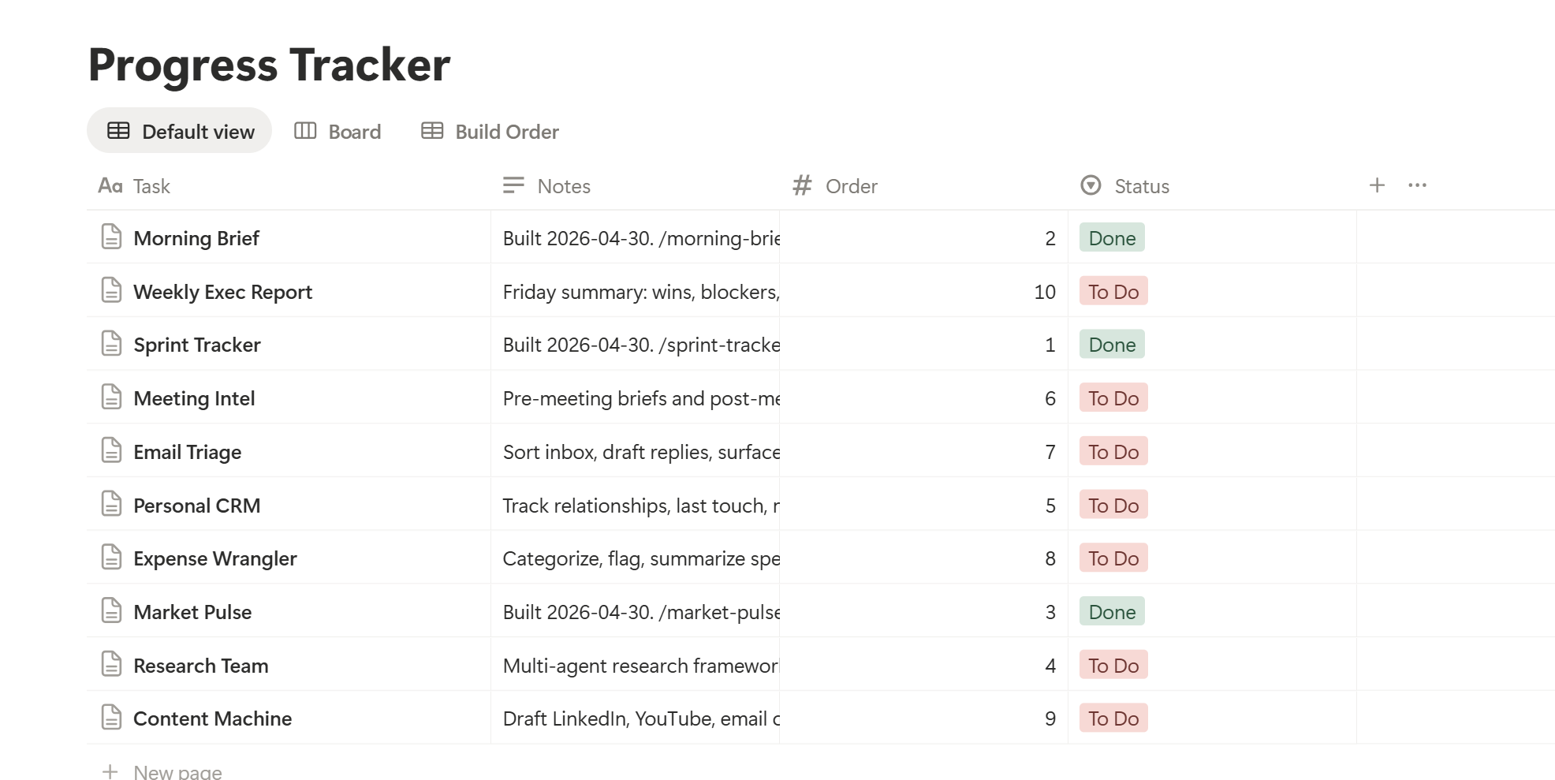
Prompt 3: Market Pulse
After running the Market pulse, a Claude.md file is created under the work folder along with a new slash command.
© All rights reserved for Dr. Ryan Ahmed @Stemplicity Inc.

Slide 14
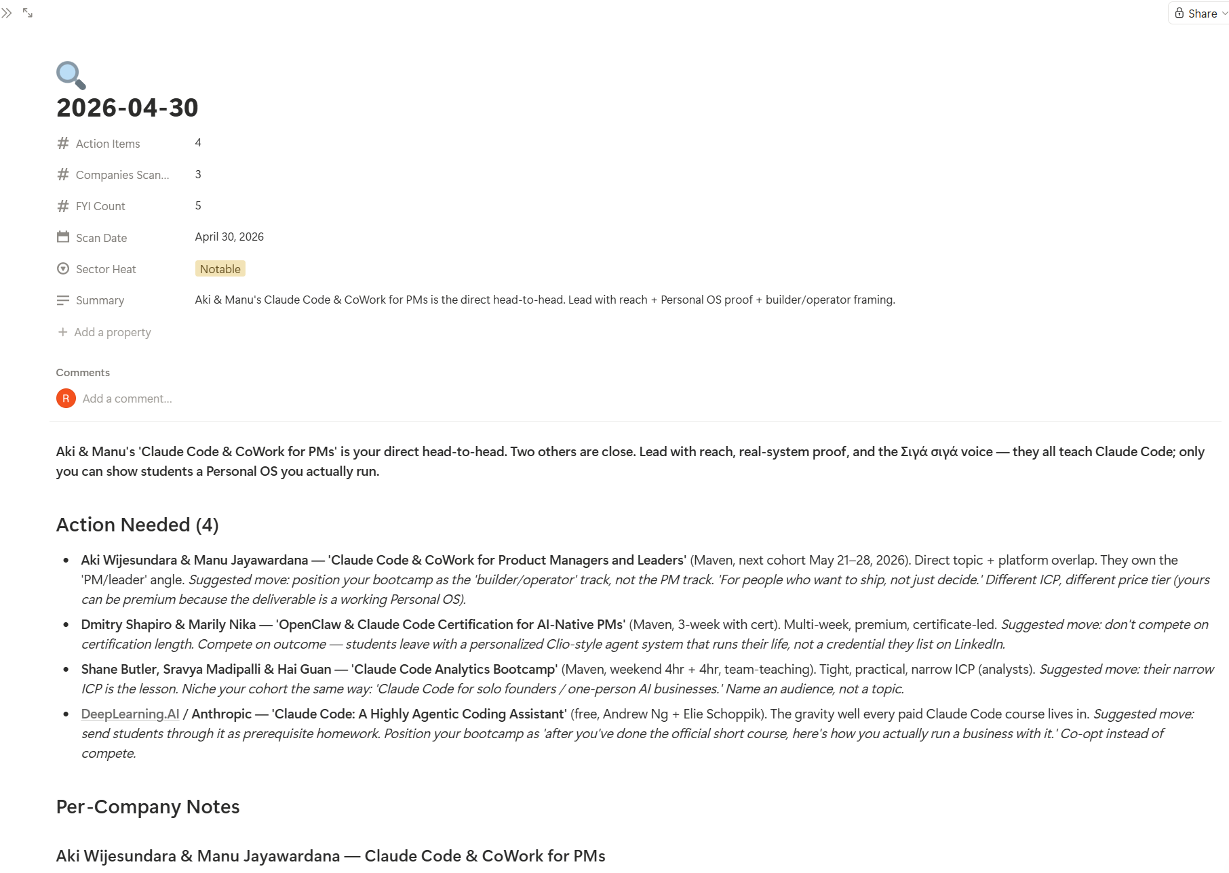
Let’s Test the market pulse slash command
/market-pulse
I am teaching a new cohort on Claude Code and Claude Cowork on Maven, I want you to search the top 3 competitors and state how I differentiate my bootcamp.
© All rights reserved for Dr. Ryan Ahmed @Stemplicity Inc.

Slide 15
Thank you!

